Slide 1

Space Wearables
Super Enhanced Field-of-View
(S.E.F)

Slide 2
The Problem
The Solution
Faced with constantly changing scenarios, an astronaut’s ability to react is often constrained by gear and utilities which don’t facilitate real-time feedback.
A wireless individual network integrates multiple scalable modular devices allowing for on-demand display and transfer of real-time data to astronauts and mission crew.

Slide 3
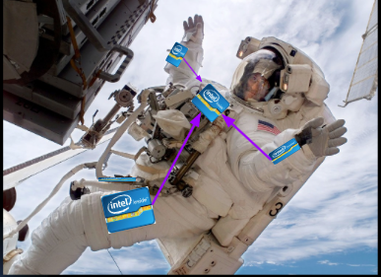
Approach
Features
Super Enhanced Field-of-View expands the astronaut's ability during extravehicular activity by feeding data from modular devices through a central microcomputer to a Heads-Up-Display.
Modular Components
Adaptability to Mission
Intercommunication

Slide 4
Fin
The Next Steps
a2015- Hackathon Developed Proof of Concept
2016- Refinement of Base Design through Test Cases
2018- R&D of Modular Devices
2020- Leverage Cloud Processing (Bluemix) for
Realtime Data Analysis
2021- Prototype built for actual trials.
2023- Pitch to NASA

